Slide 1
CRYPTO INVESTMENT FUND ANALYSIS
BIA 658 - Social Network
Analytics and Visualization
Siddharth Nilakhe
snilakhe@stevens.edu

Slide 2
Background
The cryptocurrency market has experienced significant growth, attracting the attention of investment funds worldwide.
However, the sheer diversity and volatility of the market present a challenge in discerning clear investment trends.
Our analysis stands at the intersection of data science and financial strategy, seeking to illuminate the path taken by investment firms in the crypto space.
Our project delves into the investment behaviors of crypto funds, identifying key players and patterns within this domain.

Slide 3
Problems to Solve
Which are the top five cryptocurrencies that garner the most interest from investment funds?
Are there discernible clusters or communities within the investment network that indicate a concentration around popular coins?
How do the investment patterns of firms manifest visually in the network graph, and what can this reveal about their investment strategies?
Does the regional or country-based location of a firm influence its investment patterns, indicating geo-specific investment behaviors?

Slide 4
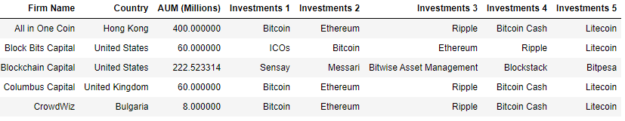
Dataset
The dataset is a 2018 Directory of Cryptocurrency Investment Funds.
Dataset has 47 features and 303 samples.
Important Features to look out for in the dataset are - Firm Name, Investments 1 to 5, Assets under Management - AUM (In Millions) and Country.
Link to the dataset - https://data.world/dmikebishop/crypto-investment-fund-directory

Slide 5
Methodology
Exploratory Data Analysis in Python: Conducted comprehensive EDA using Python to understand the dataset's characteristics and distributions, focusing on investment patterns and firm metrics.
Data Filtering and Processing Script: Utilized a Python script to filter firms with at least five non-zero investments, generating nodes and edges for network analysis. This process involved creating unique labels for nodes, mapping labels to IDs, and preparing a Data Frame suitable for visualization in Gephi.
Network Visualization in Gephi: Imported the processed data into Gephi, where we developed an intricate visual representation of the investment network. Distinguished firms and coins with unique color codes for quick visual differentiation. Utilized the Force Atlas 2 layout algorithm to arrange the network, with node sizes dynamically scaled to reflect the number of connections, underscoring the prominence of more connected entities.
Degree Range Filtering: Implemented the Degree Range filter from Gephi's Topology section to identify key cryptocurrencies with the highest number of firm investments. This filter helped in isolating the top five coins and analyzing the network's most influential entities.

Slide 6
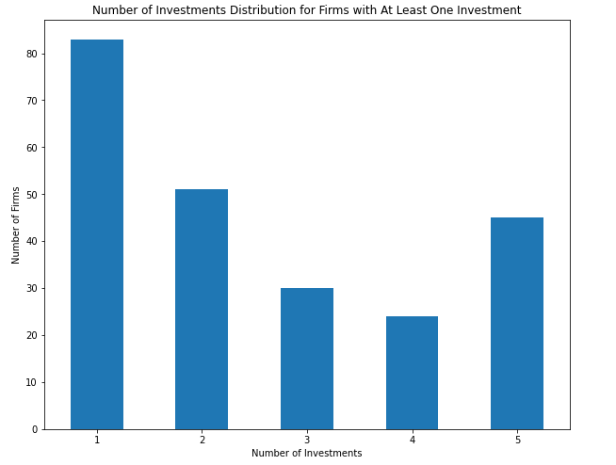
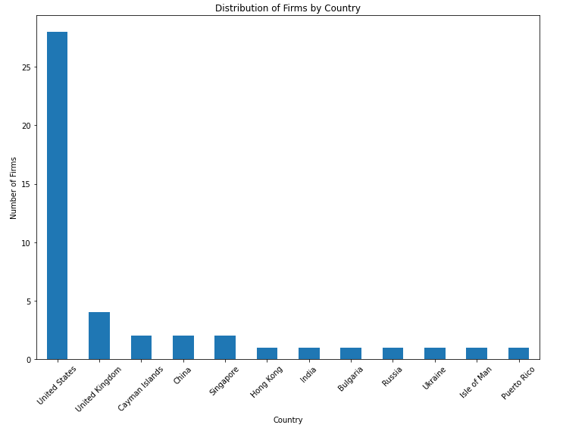
Exploratory Data Analysis
Categorizing firms by number of Investments
Categorizing firms by Country/Region

Slide 7
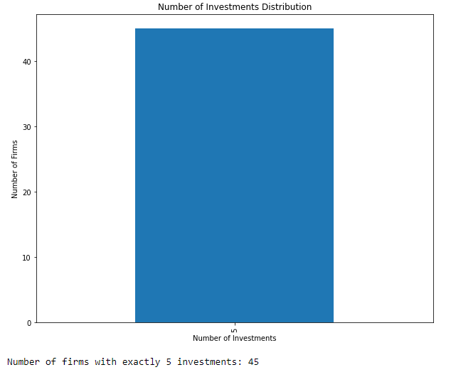
Exploratory Data Analysis
For our analysis we will only be selecting the firms with 5 investments and we will be filtering out the remaining ones.
Selecting only these firms will help us get a clear view of the social network diagram and also help in understanding the investment patterns better.

Slide 8
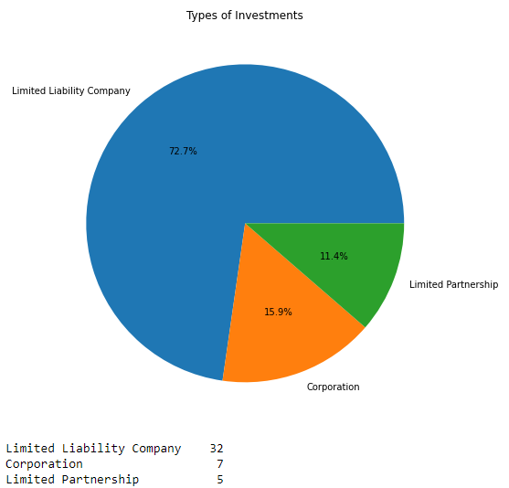
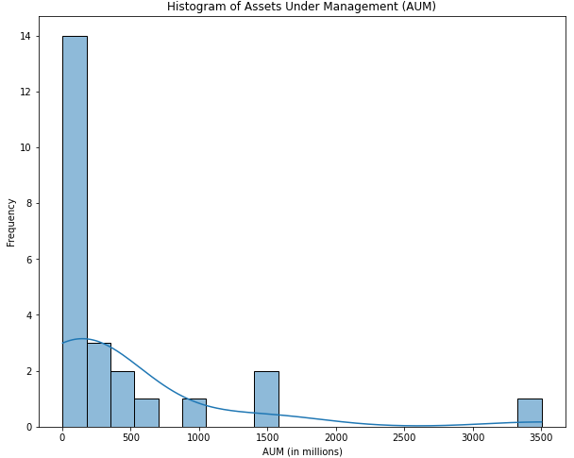
Exploratory Data Analysis
Categorizing Investment Firms by their form of incorporation
Above image suggests a skew towards smaller-sized funds in the dataset

Slide 9
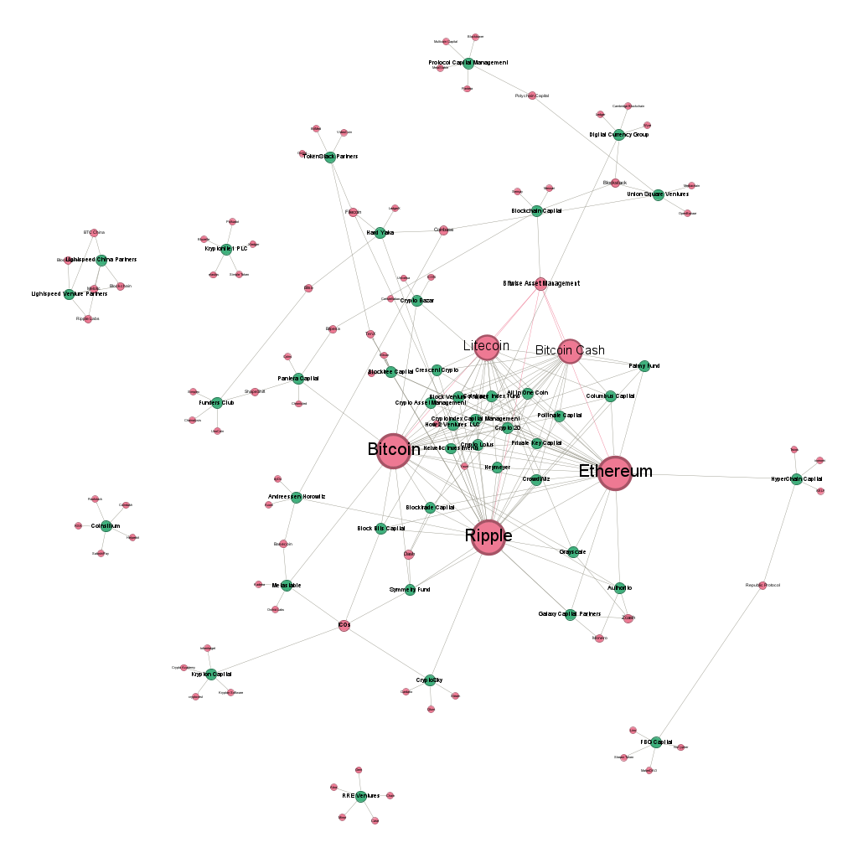
Gephi - Social Network Diagram Analysis
The network diagram provides a visual exploration into the investment landscape of cryptocurrency funds.
Prominent Cryptocurrencies: Bitcoin, Ethereum, Ripple, Litecoin and Bitcoin Cash
The larger node sizes reflect their status as the most connected assets, indicating a higher number of investments from various firms.

Slide 10
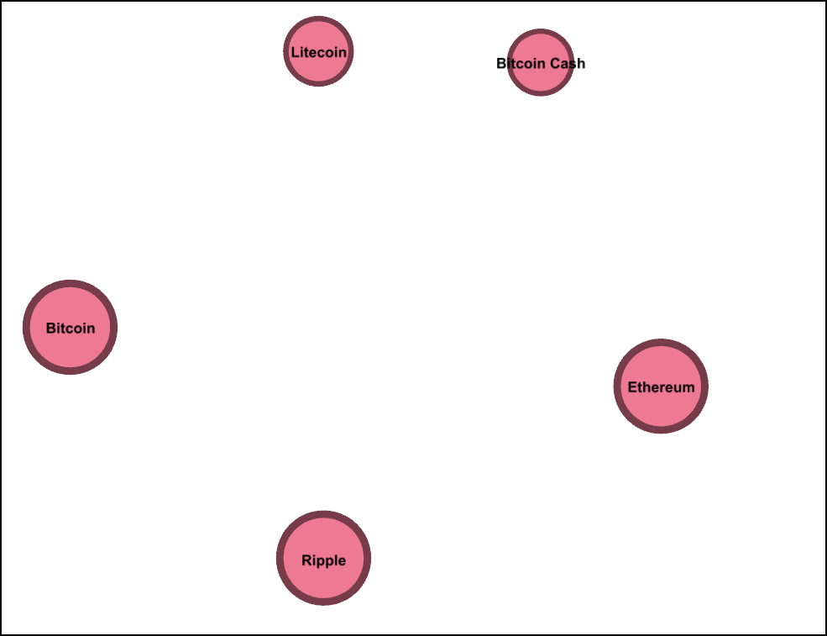
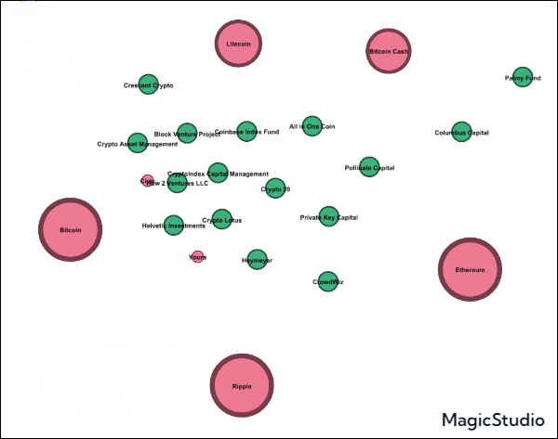
Gephi - Social Network Diagram Analysis
Degree Range Filter → 7 to 26 indicates minimum of 7 and maximum of 26 firms have invested in at least one of these 5 popular coins.
Cluster of firms (green nodes) that have invested in all of these 5 popular coins

Slide 11
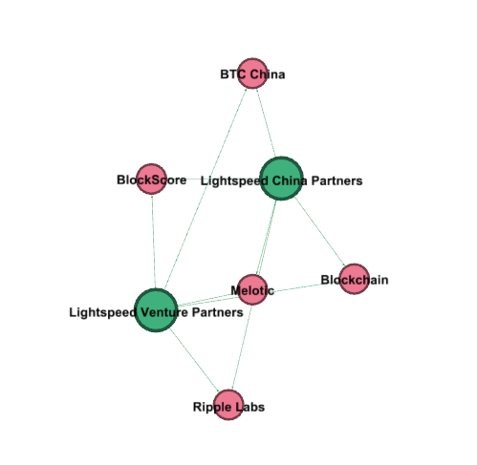
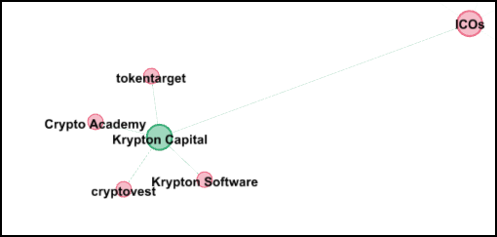
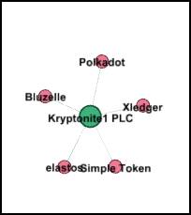
Gephi - Social Network Diagram Analysis
Investments of Firms based in Isle of Man
We can clearly see that investment patterns do change based on regions/country of origin of the firm.
These clusters can be seen cut out in the corner of the main network diagrams quite far from the central cluster.
Investments of Firms based in China

Slide 12
Conclusion
Our analysis successfully illuminated key findings within the cryptocurrency investment arena:
Data to Diagram: Despite the initial complexity of the data, we effectively transformed it into an insightful social network diagram, providing a lucid visual representation of the intricate investment relationships.
Research Questions Addressed: All set research questions were thoroughly explored, yielding comprehensive insights into the investment landscape.
Top Cryptocurrencies Unveiled: We pinpointed the five most favored cryptocurrencies by investment firms: Bitcoin, Ethereum, Ripple, Litecoin, and Bitcoin Cash.
Community Dynamics: Our network diagram revealed distinct clusters, particularly surrounding the aforementioned popular coins, underscoring their central role in the investment network.
Regional Investment Trends: The visualization facilitated a clear understanding of regional preferences, highlighting how investment patterns and strategic approaches vary by the geographic location of firms.
This project stands as a testament to the power of data transformation and visualization in extracting meaningful patterns and strategic insights from complex datasets.

Slide 13
THANK YOU
Siddharth Paraag Nilakhe
snilakhe@stevens.edu

